Slide 1

 | BMS INSTITUTE OF TECHNOLOGY AND MANAGEMENT YELAHANKA BANGALORE Department of Artificial Intelligence & Machine Learning
IoT and ML-Driven Water Forensics for Illegal Dumping Detection
1. SIRI MANJUNATH [1BY22AI098]
2. SMRITI [1BY22AI099]
3. SONALI KUMARI [1BY22AI100]
4. TISHA SAKLECHA [1BY22AI110]
Under the guidance of:
Dr. Manoj H M
Associate Professor
Dept. of AIML
BMSIT&M
2024-25

Slide 2
Content
Abstract
Introduction
Problem Statement
Objectives
Literature Survey
Limitations of Existing Systems
Proposed Methodology
Expected outcomes
Conclusion
References

Slide 3
ABSTRACT
Illegal dumping harms water bodies and ecosystems. This project uses IoT sensors for real-time monitoring, machine learning for anomaly detection, and GIS for mapping pollution sources. The system ensures rapid response and long-term environmental protection.

Slide 4
INTRODUCTION
Deteriorating water quality due to illegal dumping of industrial waste, chemicals, and other pollutants into rivers, lakes, and oceans.
Current water monitoring methods are costly, slow, and unable to provide real-time insights to rapidly address issues.
By utilizing IoT sensors and machine learning models, this project offers a way to monitor water quality in real time and respond quickly to any changes.

Slide 5
PROBLEM STATEMENT
To develop an IoT-enabled system that leverages machine learning to detect anomalies in water quality data and notifies authorities in real time, allowing for faster and more effective responses.

Slide 6
OBJECTIVES
To deploy IoT sensors to continuously monitor water quality parameters in real time.
To use machine learning algorithms to detect anomalies and identify contamination events.
To map contamination sources using GIS to visualize trends and pinpoint pollution sources.
To provide a user-friendly interface for easy data visualization.

Slide 7
LITERATURE SURVEY
YEAR | AUTHORS | PURPOSE | METHOD USED | SOURCE
2018 | Nikhil Kumar Koditala; Purnendu Shekar Pandey | Water Quality Monitoring System Using IoT and Machine Learning | IoT and Machine Learning | IEEE IoT and ML Journal
2018 | Uferah Shafi; Rafia Mumtaz; Hirra Anwar; Ali Mustafa Qamar; Hamza Khurshid | Surface Water Pollution Detection using Internet of Things | Internet Of Things (IoT) | IEEE IoT Journal
2019 | Mohammad Salah Uddin Chowdury, Talha Bin Emran, Subhasish Ghosh, Abhijit Pathak, Mohd. Manjur Alam, Nurul Absar, Karl Andersson, Mohammad Shahadat Hossain | IoT Based Real-time River Water Quality Monitoring System | Internet Of Things (IoT) | ScienceDirect IoT Journal

Slide 8
2021 | Ann Laverene Lopez, N. A. Haripriya, Kavya Raveendran, Sandra Baby, C. V. Priya | To develop a machine learning and IoT-based system for water quality monitoring and prediction. | Machine Learning (LSTM NN) for predicting water quality, integrated with Internet of Things (IoT). | IEEE International Power and Renewable Energy Conference (IPRECON)
2022 | Mengyuan Zhu, Jiawei Wang, Xiao Yang, Yu Zhang, Linyu Zhang, Hongqiang Ren, | Machine learning used in water quality monitoring and prediction. | Machine Learning | Science Direct ML Journal
2022 | Abhisek Gour, Naveen Kumar Suniya, Umesh Kumar, Kapil Parihar, Khamma Kanwar, Santosh Kumari Meena | Water Quality Monitoring in Arid Regions of Western Rajasthan | Integrated IoT-GIS Framework | ResearchGate Journal
2023 | Manikannan Govindasamy; K. Jayanthi; S. Rajagopan | IoT Product on Smart Water Quality Monitoring System (IotWq-Kit) for Puducherry Union Territory | Internet Of Things (IoT) | IEEE IoT Journal
2023 | Utsab Banerjee; Vinod P V; Karuna Sharma; Jasna Thomas; Prithviraj Sawant; Vineet Kumar Pandey | Detecting Lake Water Quality Using Machine Learning and Image Processing | Machine Learning and Image Processing | IEEE ML and Image Processing Journal

Slide 9
2024 | U G Sharanya; Koushalya M Birabbi; B.H Sahana; D Mahesh Kumar; N Sharmila; S Mallikarjun swamy | IoT-based Water Quality and Leakage Monitoring System for Urban Water Systems Using Machine Learning Algorithms | Internet Of Things (IOT) and Machine Learning (ML) | IEEE IoT Journal
2024 | Ismail Essamlali,Hasna Nhaila, Mohamed El Khaili | Advances in machine learning and IoT for water quality monitoring | IoT and Machine Learning | NLM Journal
2024 | Gasbaoui Mohammed el Amin; Benkrama Soumia; BendjimaMostefa | Water Quality Drinking Classification Using Machine Learning | Machine Learning (ML) | IEEE ML Journal
2024 | Omar Otoniel Flores-Cortez | To create a low-cost, IoT-based system, particularly in developing countries. | IoT and ML for real-time data collection and remote monitoring of water quality. | IEEE Consumer Communications & Networking Conference (CCNC)

Slide 10
LIMITATIONS OF EXISTING SYSTEM
Limited monitoring of advanced or unconventional pollutants.
Inability to detect sudden anomalies caused by illegal dumping.
Dependency on stable internet connectivity for data transmission.
Lack of integration of advanced ML models for precise detection.
High cost and maintenance of reliable sensor networks.

Slide 11
PROPOSED METHODOLOGY
Data Collection
GIS Mapping for Contamination Tracking
Real-Time Alerts
Anomaly Detection Using ML
Predictive Analysis for Future Trends
System Testing and Calibration
IoT Sensor Deployment
Data Preprocessing
Fig 1 : Workflow model for water quality monitoring and analysis

Slide 12
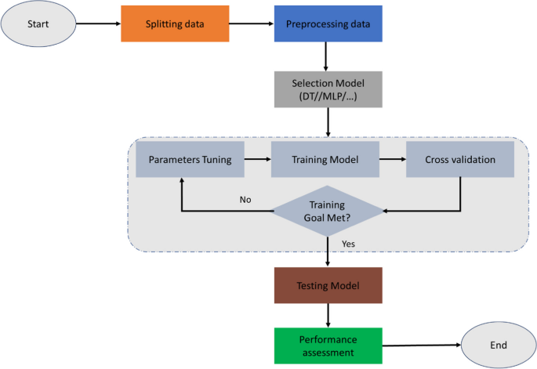
Fig 2 : Flowchart of machine learning modeling

Slide 13
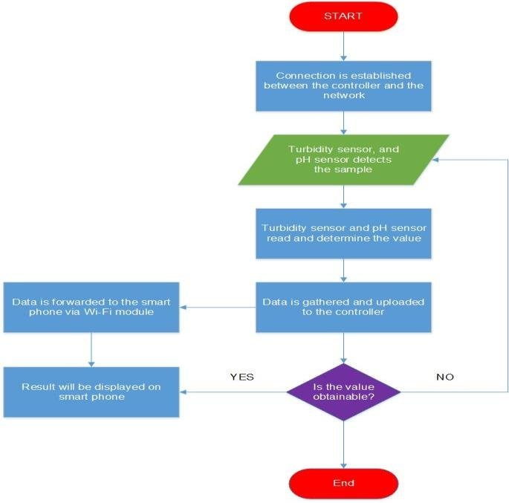
Fig 3 : Flowchart of IoT water monitoring system

Slide 14
EXPECTED OUTCOMES
Improved Water Quality Monitoring
Visual mapping for focused interventions.
Early Detection of Contamination Events
Real-Time Alerts and Decision Support
Efficient Pollution Management
Scalable and Adaptable System

Slide 15
CONCLUSION
The proposed system combines IoT, machine learning, and GIS to provide a solution to illegal dumping, ensuring better protection of water resources and less human intervention.

Slide 16
REFERENCES
[1]. N. K. Koditala and P. S. Pandey, "Water Quality Monitoring System Using IoT and Machine Learning," IEEE IoT and Machine Learning Journal, 2018.
[2]. U. Shafi, R. Mumtaz, H. Anwar, A. M. Qamar, and H. Khurshid, "Surface Water Pollution Detection using Internet of Things," IEEE Internet of Things Journal, 2018.
[3]. M. S. U. Chowdury, T. B. Emran, S. Ghosh, A. Pathak, M. M. Alam, N. Absar, K. Andersson, and M. S. Hossain, "IoT Based Real-time River Water Quality Monitoring System," Science Direct IoT Journal, 2019.
[4]. A. L. Lopez, N. A. Haripriya, K. Raveendran, S. Baby, and C. V. Priya, "Water quality prediction system using LSTM NN and IoT," 2021 IEEE International Power and Renewable Energy Conference (IPRECON), 2021
[5]. Zhu, J. Wang, X. Yang, Y. Zhang, L. Zhang, and H. Ren, "Machine learning used in water quality monitoring and prediction," ScienceDirect ML Journal, 2022.
[6]. Gour, N. K. Suniya, U. Kumar, K. Parihar, K. Kanwar, and S. K. Meena, "Water Quality Monitoring in Arid Regions of Western Rajasthan: Integrated IoT-GIS Framework," ResearchGate Journal, 2022.

Slide 17
[7]. M. Govindasamy, K. Jayanthi, and S. Rajagopan, "IoT Product on Smart Water Quality Monitoring System (IoT Wq-Kit) for Puducherry Union Territory," IEEE Internet of Things Journal, 2023.
[8]. U. Banerjee, V. P. V, K. Sharma, J. Thomas, P. Sawant, and V. K. Pandey, "Detecting Lake Water Quality Using Machine Learning and Image Processing," IEEE ML and Image Processing Journal, 2023.
[9]. U. G. Sharanya, K. M. Birabbi, B. H. Sahana, D. M. Kumar, N. Sharmila, and S. M. Swamy, "IoT-based Water Quality and Leakage Monitoring System for Urban Water Systems Using Machine Learning Algorithms," IEEE Internet of Things Journal, 2024.
[10]. Essamlali, H. Nhaila, and M. El Khaili, "Advances in Machine Learning and IoT for Water Quality Monitoring," NLM Journal, 2024.
[11]. G. M. el Amin, B. Soumia, and B. Mostefa, "Water Quality Drinking Classification Using Machine Learning," IEEE ML Journal, 2024.
[12]. O. O. Flores-Cortez, "A Low-Cost IoT System for Water Quality Monitoring in Developing Countries," IEEE 21st Consumer Communications & Networking Conference (CCNC), 2024

